Slide 1
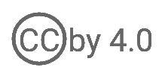
WSO2 API Manager 4.2.0 Developer Advanced
Deploy API Manager on K8S
WSO2 Training

Slide 2
Why Kubernetes?

Slide 3
Docker is Great….But?
Docker provides a friendly environment for developers to develop cloud-native applications
But how to manage
Auto scaling
Auto healing
Production upgrades via Blue Green/Canary deployments

Slide 4
Kubernetes
Kubernetes (K8s) is an open source system for managing containerized applications across multiple hosts, providing basic mechanisms for deployment, maintenance, and scaling of applications
Provides a runtime environment for Docker containers
Scale and load balance Docker containers
Abstract away the infrastructure that containers run on
Monitor/health check containers
Declarative definition for running containers
Update containers (also rolling updates)
Storage mounting (allow abstracting infrastructure)
Service discovery and exposure
Labelling and selection of any kind of object

Slide 5
Why Kubernetes?
Availability and Scalability
If a container crashes in Docker, your application stops working
K8s would automatically spin up a new container, and ensure your application always has the specified number of containers running
K8s can scale up/down dynamically based on the resource usage (Horizontal Pod Autoscaling)
It is now possible to auto-scale backend or managed API horizontally, based on custom metrics.

Slide 6
Why Kubernetes?
Networking and Port Mapping
Service Discovery
Need to scale up containers / restart an existing one? In Docker you will need to handle wiring with IPs, etc.
K8s provides an abstraction over IP addresses, so the wiring part is automatic
Load balanced endpoints and consistent addressing is available OOTB
Multi-host routing
By default, uses bridge networking - limited to the same Docker host!
A real deployment can span across multiple hosts

Slide 7
Why Kubernetes?
Health Checks and Monitoring
K8s Probes
User-defined criteria to determine health and service readiness of the deployed containers
K8s makes scaling, healing, and eviction decisions based on these checks
Logging and Stat Extensibility
K8s provides extensive support and seamless integration with external log analyzers and metric monitoring systems
Log Drivers
Prometheus
K8s itself packs a dashboard containing audit and cluster health information

Slide 8
What do you configure when installing API Manager?
API Manager nodes
Load balancer
Database engine
Shared file system
How do you align these requirements with Kubernetes?

Slide 9
Persistence Volumes
Storage consistency
Docker volume mounts - limited to the docker host machine
K8s persistent volumes - works across multiple machines, has multi cloud support
Can extend support for multiple Cloud Storage Service Providers

Slide 10
Kubernetes Pods and Deployments
Pods:
Runs a single set of containers
Good for one-off dev purposes
Rarely used directly in production
Deployment:
Runs a set of identical pods
Monitors the state of each pod, updating as necessary
Good for dev
Good for production

Slide 11
Sample Deployment Configuration
apiVersion: apps/v1 # for versions before 1.9.0 use apps/v1beta2
kind: Deployment
metadata:
name: nginx-deployment
spec:
selector:
matchLabels:
app: nginx
replicas: 2 # tells deployment to run 2 pods matching the template
template:
metadata:
labels:
app: nginx
spec:
containers:
- name: nginx
image: nginx:1.7.9
ports:
- containerPort: 80

Slide 12
Deployment Architecture

Slide 13
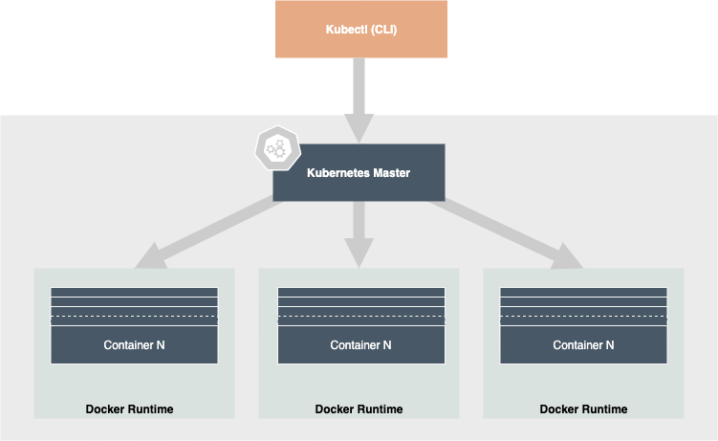
Kubernetes Deployment Architecture

Slide 14
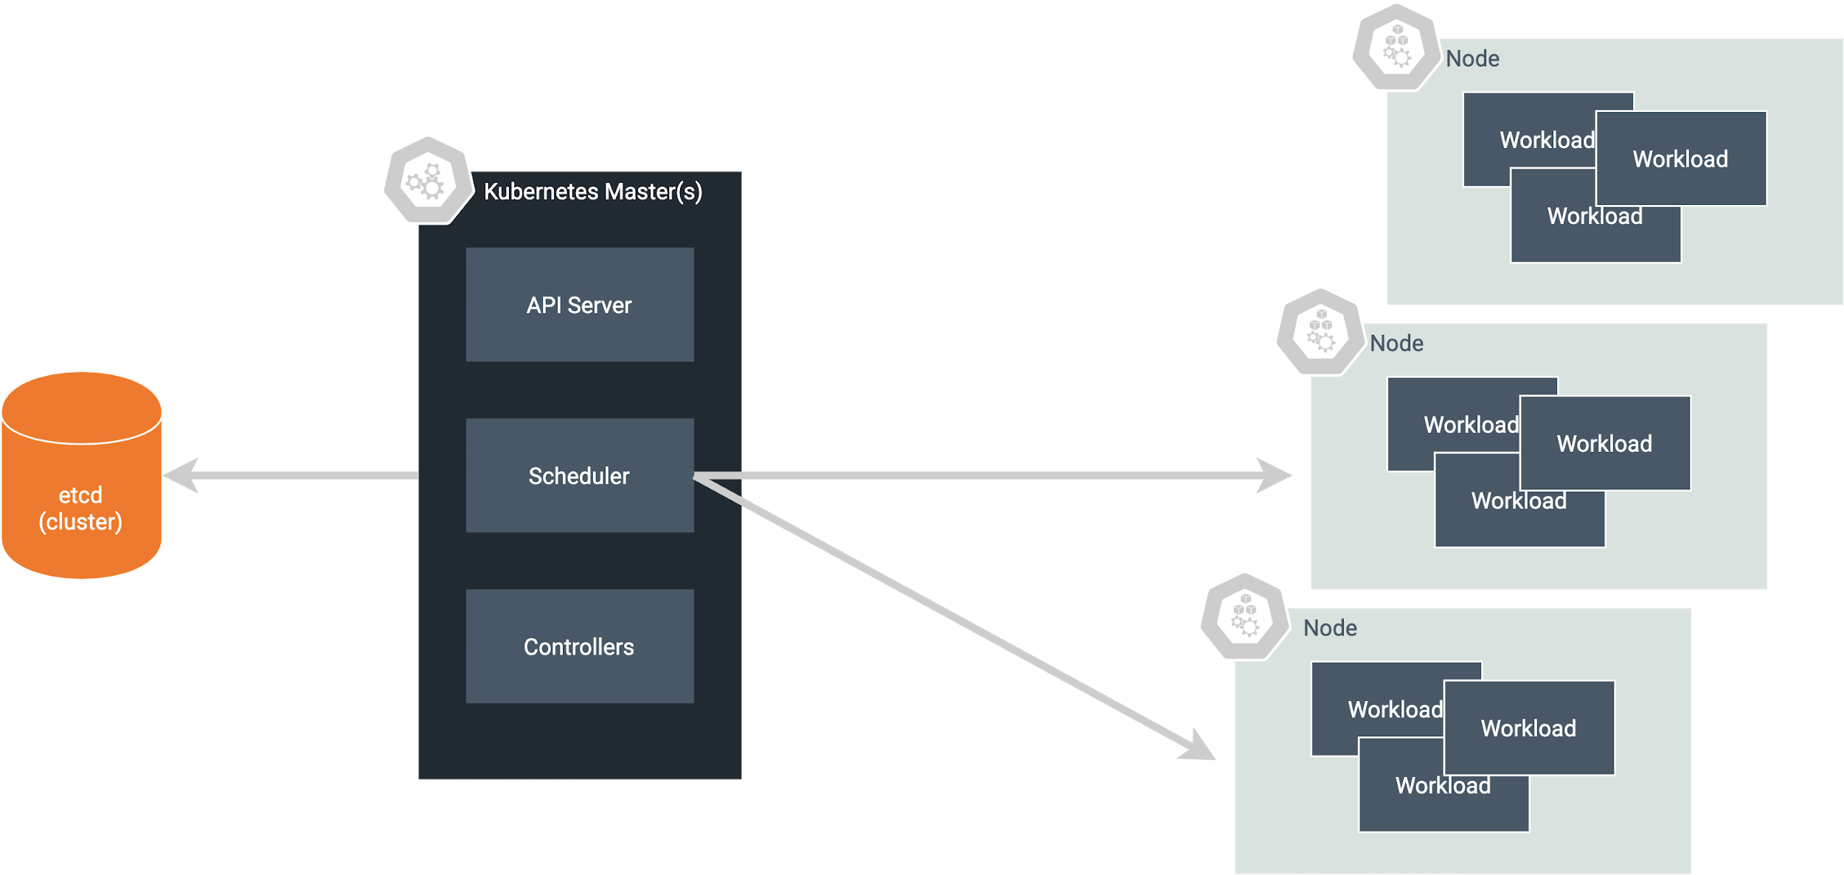
Deploying Kubernetes Cluster

Slide 15
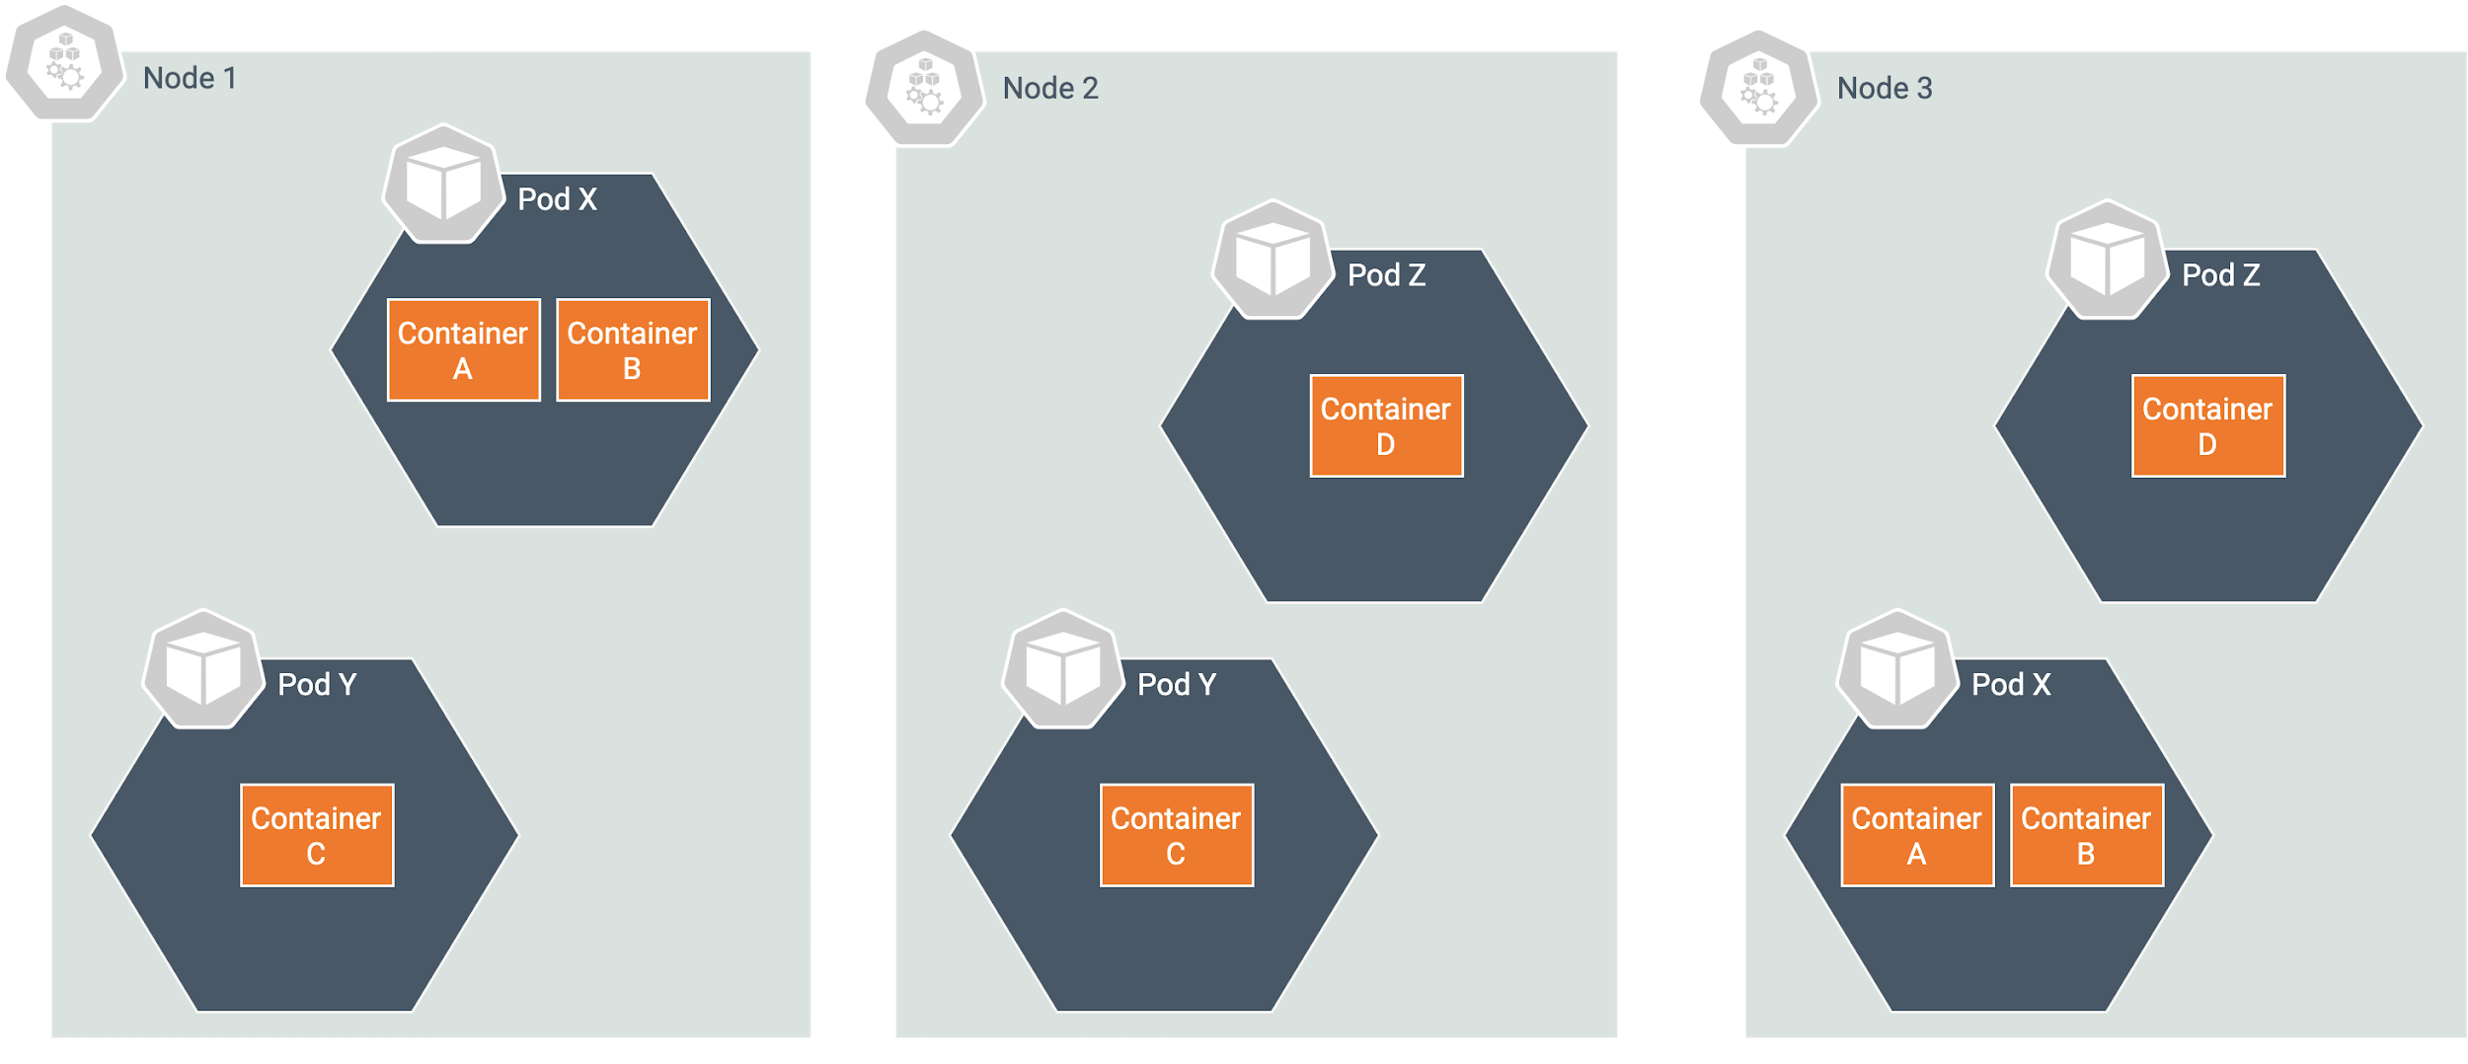
Deployment is Not Enough and Service is Required
If you use a deployment to run your app, it can create and destroy pods dynamically
Each pod gets its own IP address and when pods are spawned, IPs change dynamically
Service provides a static address for the pods (Load Balancer)

Slide 16
Sample Service Definition
apiVersion: v1
kind: Service
metadata:
name: my-service
spec:
selector:
app: nginx
ports:
- protocol: TCP
port: 80
targetPort: 8080

Slide 17
Ingress

Slide 18
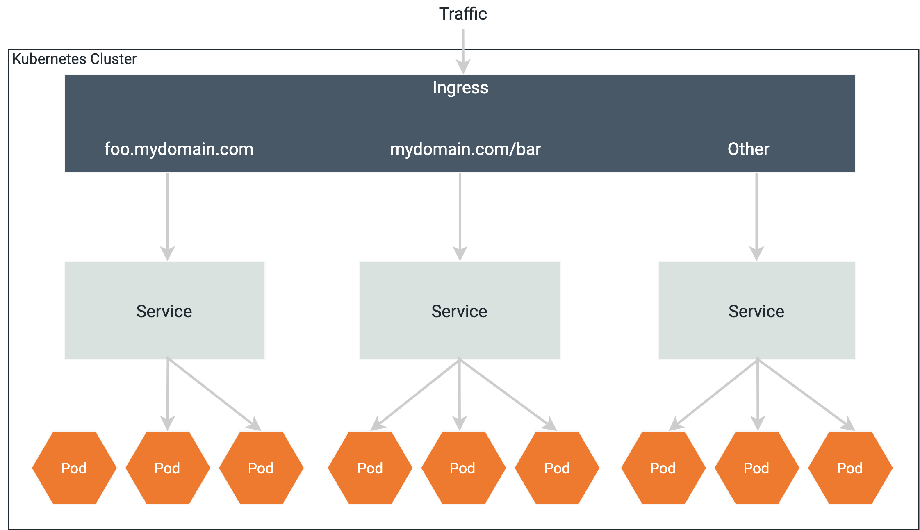
Ingress
Ingress exposes HTTP and HTTPS routes from outside the cluster to services within the cluster. Traffic routing is controlled by rules defined on the Ingress resource.
Kubernetes NodePort vs LoadBalancer vs Ingress? When should I use what?

Slide 19
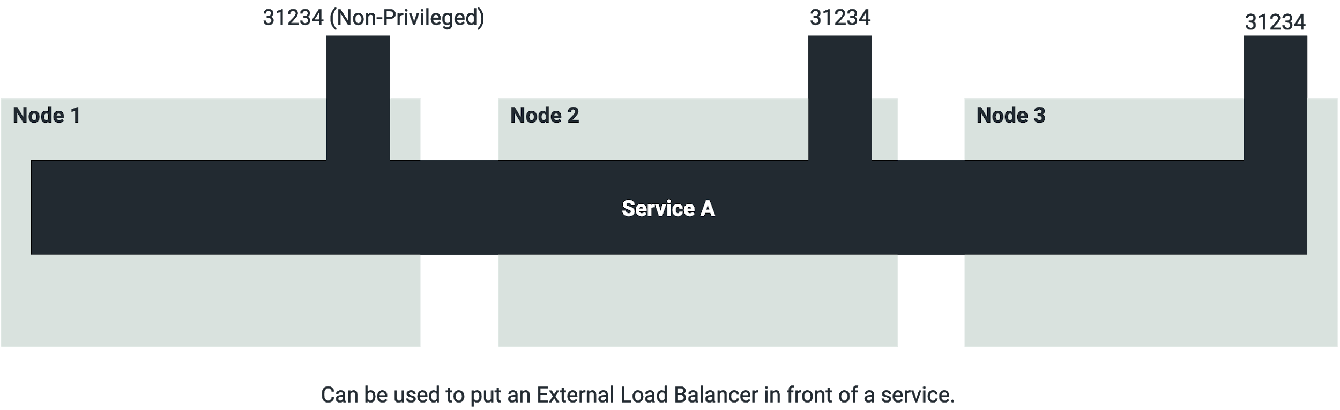
Exposing Service - NodePort
ports:
# Three types of ports for a service
# nodePort - a static port assigned to each of the nodes
# port - port exposed internally in the cluster
# targetPort - the container port to send requests to
- nodePort: 30163
port: 8080
targetPort: 80

Slide 20
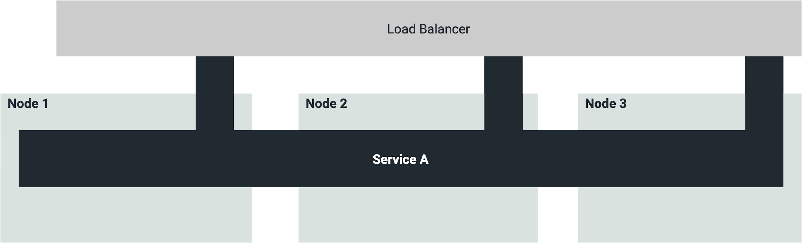
Exposing Service - LoadBalancer
How this is done depends on Cloud Provider (Azure, AWS, …)
Will provision a Load Balancer on the cloud provider’s infrastructure.
E.g., Elastic LB, Azure LB

Slide 21
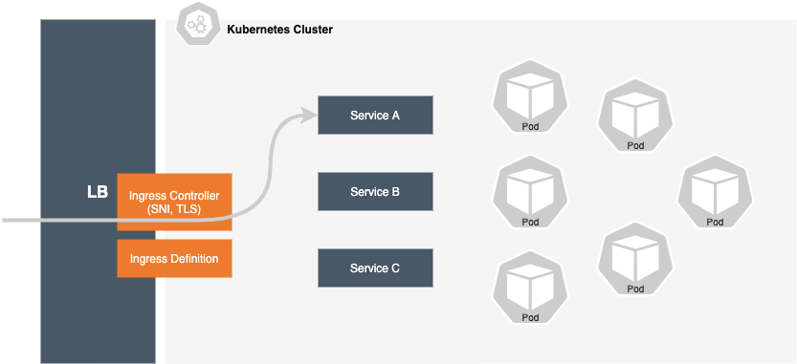
Exposing Service - Ingress
Ingress definition:
E.g., “route Host x.y.z to service A”, “Use TLS Certificate abc for host x.y.z”
Abstract definition of rules.
Implemented by ingress controller
Flexible; Leverages load balancer on cloud provider
Can provide SNI (Server Name Indication) and TLS termination

Slide 22
Config Maps
ConfigMaps bind configuration files, command-line arguments, environment variables, port numbers, and other configuration artifacts to your pods' containers and system components at runtime.
ConfigMaps allow you to separate your configurations from your pods and components
E.g., api-manager.xml, master-datasources.xml
ConfigMaps are useful for storing and sharing non-sensitive, unencrypted configuration information

Slide 23
Secrets
Secrets are secure objects which store sensitive data, such as passwords, OAuth tokens, and SSH keys, in your clusters. Storing sensitive data in Secrets is more secure than plaintext ConfigMaps or in Pod specifications.
Using Secrets gives you control over how sensitive data is used, and reduces the risk of exposing the data to unauthorized users.

Slide 24
Mount Config Maps and Secrets to Deployments
apiVersion: apps/v1
kind: Deployment
metadata:
name: wso2apim-with-analytics-apim
................................
volumeMounts:
- name: apim-conf
mountPath: /home/wso2carbon/wso2-config-volume/repository/conf
- name: apim-conf-datasources
mountPath: /home/wso2carbon/wso2-config-volume/repository/conf/datasources
......................
imagePullSecrets:
- name: wso2creds
volumes:
- name: apim-conf
configMap:
name: apim-conf
- name: apim-conf-datasources
configMap:
name: apim-conf-datasources

Slide 25
Production Deployment

Slide 26
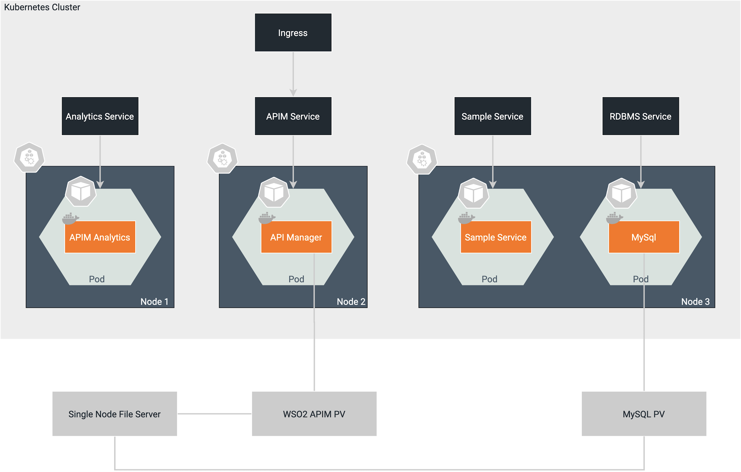
Production Deployment

Slide 27
Kubectl Commands
Deploy configuration
kubectl apply -f <deployment.yaml>
List pods
kubectl get pods
Go inside a pod
kubectl exec -it <pod_name> -- /bin/bash

Slide 28

Let’s try it out!
Deploying API Manager on Kubernetes
Follow
https://www.tutorialspoint.com/kubernetes/
Try Out
https://medium.com/@andriperera.98/how-to-deploy-wso2-api-manager-in-production-grade-kubernetes-268a65a41fa2

